Slide 1
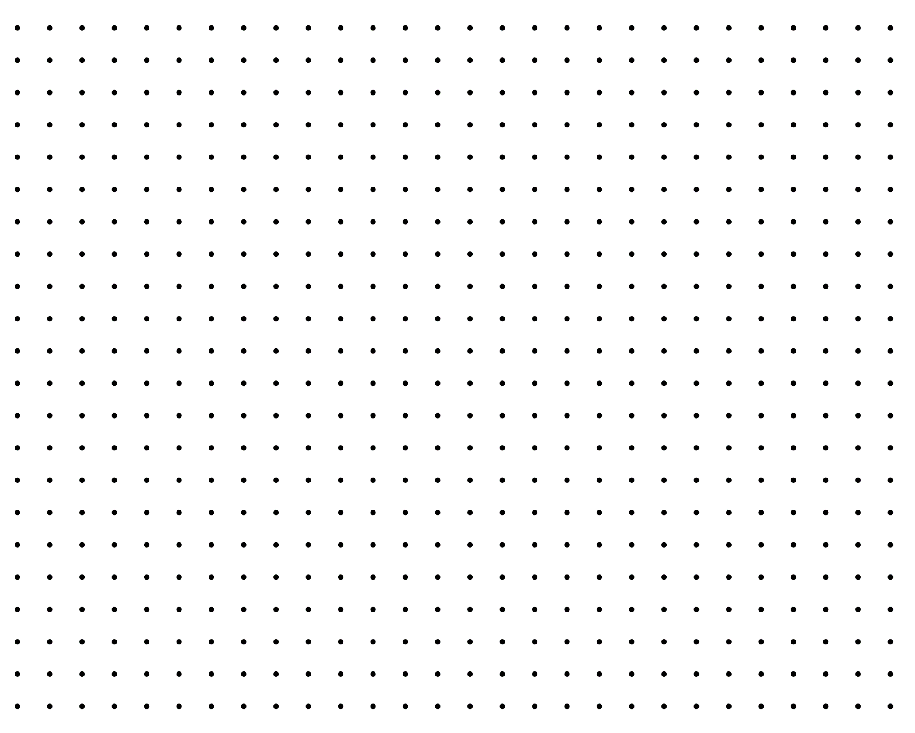
Statistics and Probability

Slide 2
Finding the z-score of a random variable X

Slide 3

Finding the z-score
Converting a normal random variable X to a standard normal random variable Z.
Use the formula for calculating the z-score:
$z=\frac{x−μ}{σ}$ OR $z=\frac{x−\overline{x}}{s}$

Slide 4

Example 1
In a math test given $\overline{x}=77$ and $s=14$. Find the z-score that corresponds to each of the following scores (in 2 decimal places).
X = 63
X = 50
X = 112
X = 84

Slide 5

Let’s try!
In a math test given $\overline{x}=32$ and $s=4$. Find the z-score that corresponds to each of the following scores (in 2 decimal places).
X = 45
X = 30
X = 25
X = 52

Slide 6
The Standard Normal Distribution

Slide 7
Standard Normal Distribution
The standard normal distribution, which is denoted by Z, is also a normal distribution having a mean of 0 and a standard deviation of 1.

Slide 8
Standard Normal Distribution
Normal variable is standardized by setting the mean to 0 and standard deviation to 1. This is for the purpose of simplifying the process in approximating areas for normal curves.

Slide 9
Finding The Area Under The Normal Curve

Slide 10

Finding The Area Under The Normal Curve
Formula used to manually compute the approximate area:
$$f\left(z\right)=\frac{1}{\sqrt{2π}}e^{−\frac{z^{2}}{2}}$$

Slide 11
Z-Table
The outermost column and row represent the z-values. The first two digits of the z-value are found in the leftmost column and the last digit (hundredth place) is found on the first row.

Slide 12
Example:
Find the area that corresponds to z = 1.85.
Steps:
Locate the first two digits 1.8 in the leftmost column and the last digit, .05, can be located at the first row.
Then find their intersection which gives the corresponding area.

Slide 13
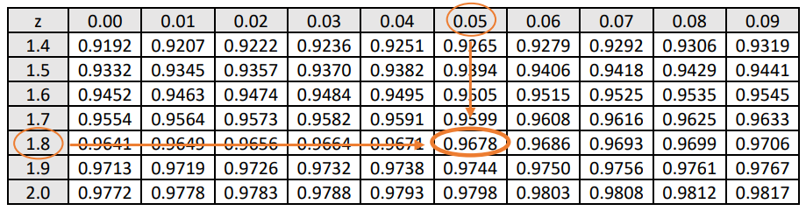
Example:
Find the area that corresponds to z = 1.85.
Therefore, given z = 1.85, the area is equal to 0.9678.

Slide 14
Example:
2. Find the area that corresponds to z = 2.67
Steps:
Locate the first two digits 2.6 in the leftmost column and the last digit, .07, can be located at the first row.
Then find their intersection which gives the corresponding area.

Slide 15
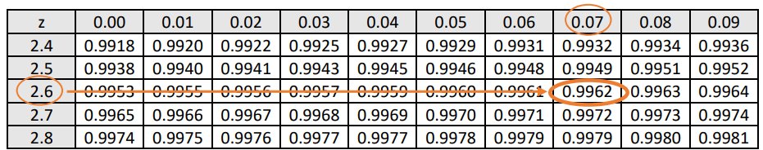
Example:
2. Find the area that corresponds to z = 2.67
Therefore, given z = 2.67, the area is equal to 0.9962

Slide 16
Example:
3. Find the area that corresponds to z = 1.29 Steps:
Locate the first two digits 1.2 in the leftmost column and the last digit, .09, can be located at the first row.
Then find their intersection which gives the corresponding area.

Slide 17
Example:
4. Find the area that corresponds to z = 3

Slide 18
Example:
5. Find the area that corresponds to z = - 0.64 Steps:
Locate the first two digits -0.6 in the leftmost column and the last digit, .04, can be located at the first row.
Then find their intersection which gives the corresponding area.

Slide 19
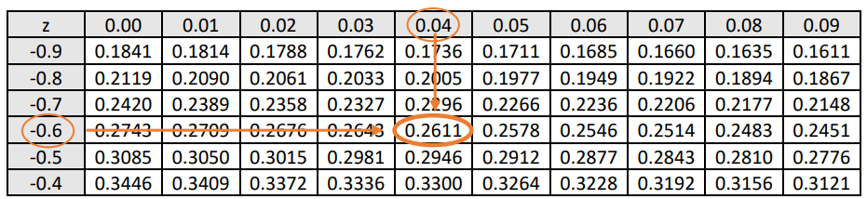
Example:
5. Find the area that corresponds to z = -0.64
Therefore, given z = -0.64, the area is equal to 0.2611

Slide 20
Regions Under The Normal Curve That Corresponds To Different Standard Normal Values

Slide 21
Regions Under The Normal Curve That Corresponds To Different Standard Normal Values
The probability notation P(a < Z < b) indicates that the z-value is between a and b, P(Z > a) means z-value is above a and P(Z < a) means z-value is below a.

Slide 22
Steps in finding the area under the normal curve.
Graph the z-score in normal curve.
Observe the working equation.
Plot the intersection of the z-scores in Standard Normal Table.
Perform the operation needed.
Express the answer in percent form.

Slide 23
Example:
Find the proportion of the area between z = -1.25 and 2.19, this can be expressed as P(-1.25 < Z < 2.19)

Slide 24
Example:
2. Compute the probability using the standard normal curve.
a. P(Z < 1.67) = ______________

Slide 25
Example:
2. Compute the probability using the standard normal curve.
a. P(Z > -0.65) = ______________

Slide 26

Example 1
Graph the following z-score:
Between $z=0$ and $z=1.54$
Between $z=0$and $z=−2.12$
Between $z=−2.35$ and $z=1.68$
Between $z=1.52$ and $z=2.5$
To the right of $z=−1.31$
To the right of $z=1.78$

Slide 27

Worksheet 4
Graph the following z-scores:
Between $z=0$ and $z=1.32$
Between $z=0$and $z=−2.48$
Between $z=1.32$ and $z=1.96$
Between $z=−2.56$ and $z=2.56$
To the right of $z=−1.23$
To the left of $z=1.54$
Between $z=−2.86$ and $z=−1.31$
Between $z=−1.78$ and $z=2.11$

Slide 28
Problems Involving z-scores and Normal Curve

Slide 29
Example 1
In a job fair sponsored by the three big companies, 2500 applicants applied for a job. Their mean age was found to be 35 with a standard deviation of 5 years.
A. What is the probability of the job applicants who are below 33 years old?

Slide 30
Example 2
In a job fair sponsored by the three big companies, 2500 applicants applied for a job. Their mean age was found to be 35 with a standard deviation of 5 years.
B. Find the percentage of the applicants who are above 39 years old.

Slide 31
Example 3
In a job fair sponsored by the three big companies, 2500 applicants applied for a job. Their mean age was found to be 35 with a standard deviation of 5 years.
C. How many applicants have ages between 28 and 44 years?

Slide 32
Worksheet 5
A researcher studies the diesel consumption of traditionally manufactured motorcycles sold in the Philippines. The data taken at random and normally distributed to an average consumption of 25 kilometers in a liter and a standard deviation of 3 kilometers.
What percentage of the motorcycles consume 29 or more kilometers in a liter?
How about 23 – 30?

